Slide 1
HOTEL MANAGEMENT FOR
“OCCASION FAMILY RESTAURANT AND BANQUET HALL”

Slide 2
CONTENTS
ABSTRACT
INTRODUCTION
EXISTING SYSTEM WITH DRAWBACKS
PROPOSED SYSTEM WITH FEATURES
HARDWARE AND SOFTWARE REQURIMENTS
DATA FLOW ANALYSIS
DATABASE DICTIONARY
IMPLEMENTATION
TESTING
RESULTS
CONCLUSION
FUTURE SCOPE AND ENHANCEMENTS

Slide 3
ABSTRACT
Most of the restaurants at various cities across the globe are using the manual system for customer services. The customer need to go to restaurant to order the food, to book the banquet halls and rooms, where the receptionist will go to manager to make approval of the order and bill. This type of manual ordering system in restaurant will leads to some human errors and time taking process. This Restaurant Service Management which can be used to manage activities like storing customer details, booking rooms and banquet halls, ordering food for rooms, checkout rooms and generating bills. The system provides the information regarding the different services that are available and their status specific to availability. The customers can visit the website and register themselves with the required information that is expected by the system and can easily avail services by one click.

Slide 4
INTRODUCTION
The project Online Hotel Management System is a web-based application that allows the Hotel Manager & Owner to handle all hotel activities online easily and safely.
Hotel Management System provides room booking, hall booking, ordering the food and view payment details. The system will be so simple and attractive which will make the customer comfortable to use and choose their rooms and halls.
Customers can book an available room, halls and order food online and the system will automatically generate the payment details according to the number of days the type of room and hall is booked.

Slide 5
EXISTING SYSTEM WITH DRAWBACKS
Manual Reservation System
Front Desk Operations
Food order
Paper-Based Billing 5.Traditional Feedback Collection

Slide 6
PROPOSED SYSTEM WITH FEATURES
Reservation System
Integrated Front Desk Operations
Real-time Room Management 4.Automated Feedback Collection

Slide 7
HARDWARE AND SOFTWARE REQUIREMENTS
HARDWARE REQUIREMENTS:
The following are the hardware requirements which we have used in our project.
Processor needed: Any Processor with speed 1.1GHz.
RAM: 8 GB or more.
Hard disk: 512 GB or more.
SOFTWARE REQUIREMENTS:
The following are the software requirements, technologies specified in our project.
Operating System: Windows 7 or Higher.
Language: Java.
Front – End: HTML, CSS, Java Script.
Back – End: My SQL.
Web Server: XAMPP.
Software: POSTMAN.

Slide 8
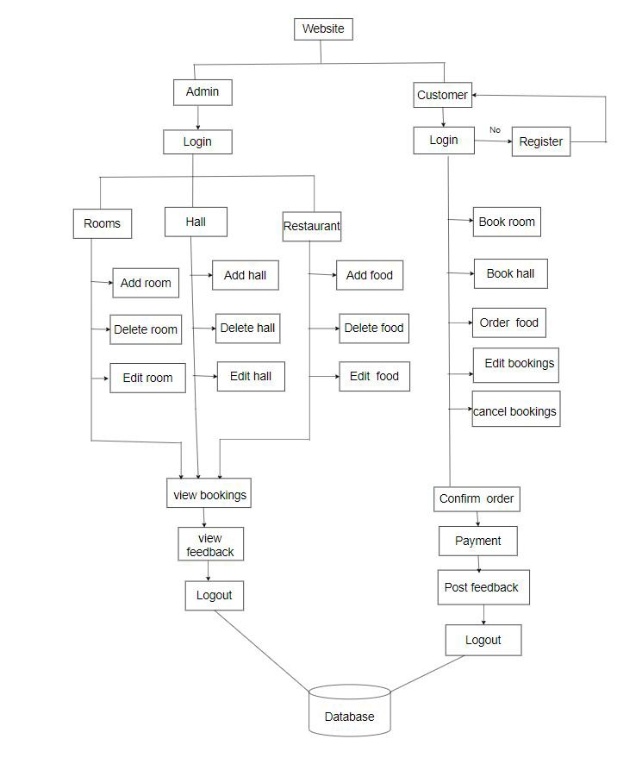
DATA FLOW ANALYSIS
BLOCK DIAGRAM

Slide 9
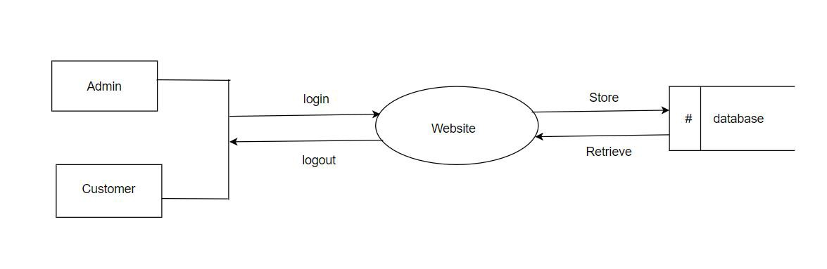
Data Flow Diagrams:
Context level DFD
Top level DFD
Context Level DFD

Slide 10
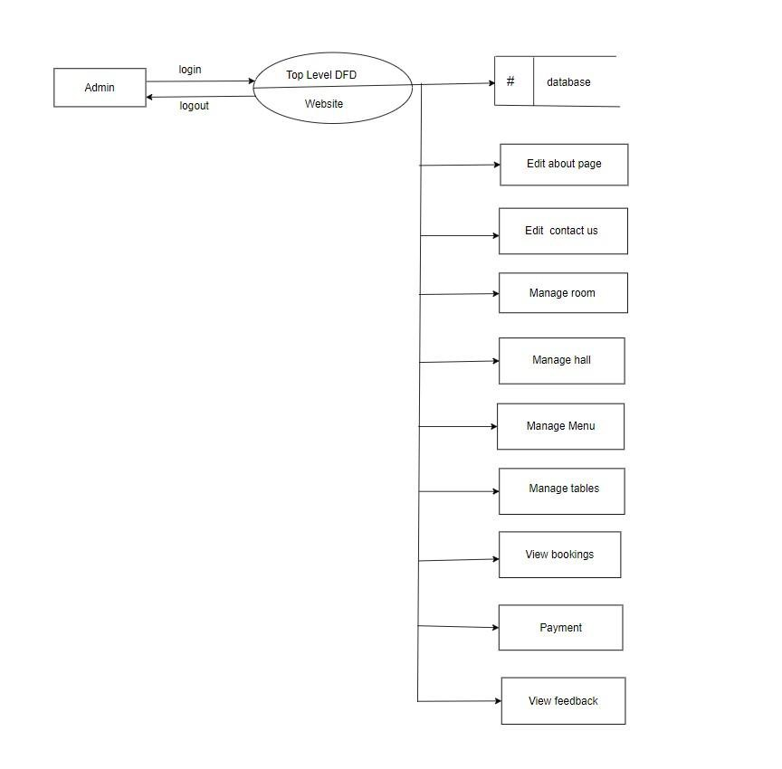
Top level DFD for Admin

Slide 11
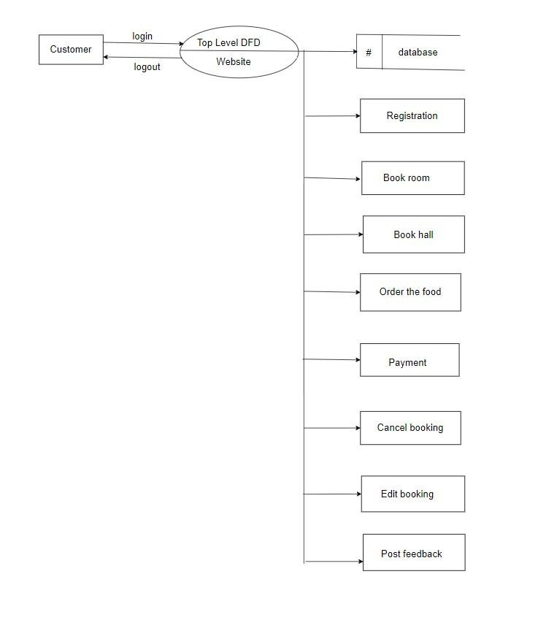
Top level DFD for Customer

Slide 12
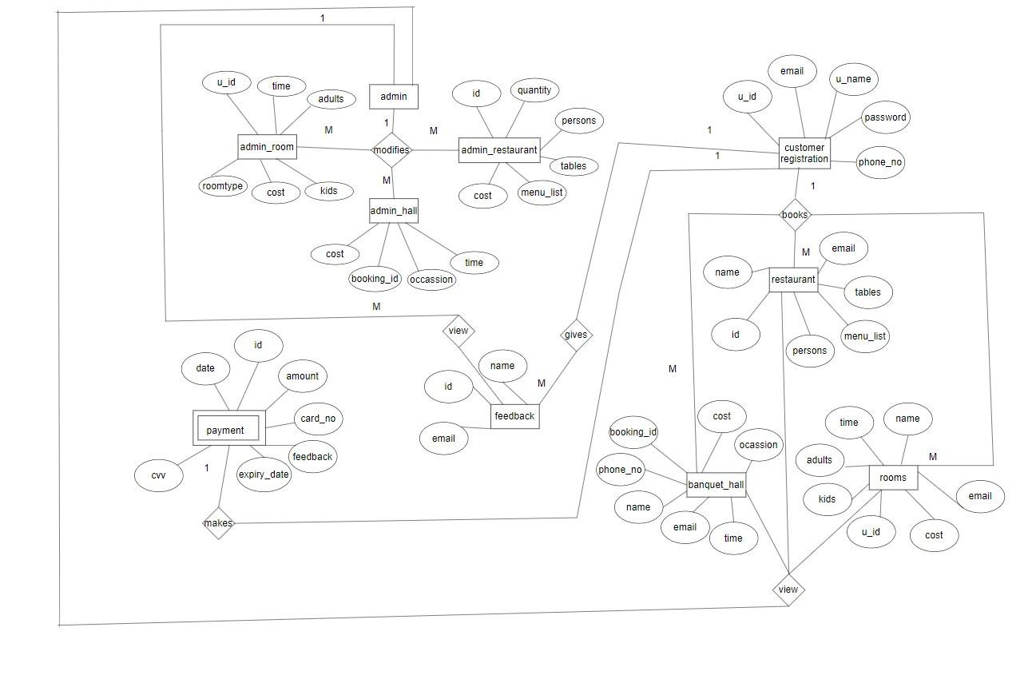
ER Diagram

Slide 13
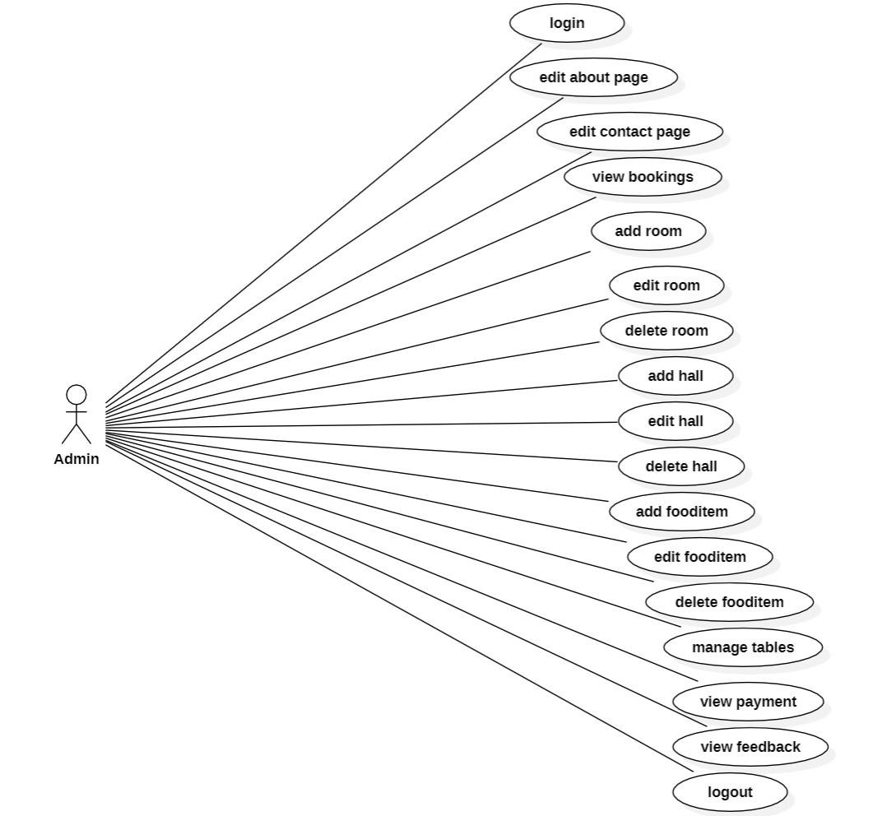
Use Case Diagram for Admin

Slide 14
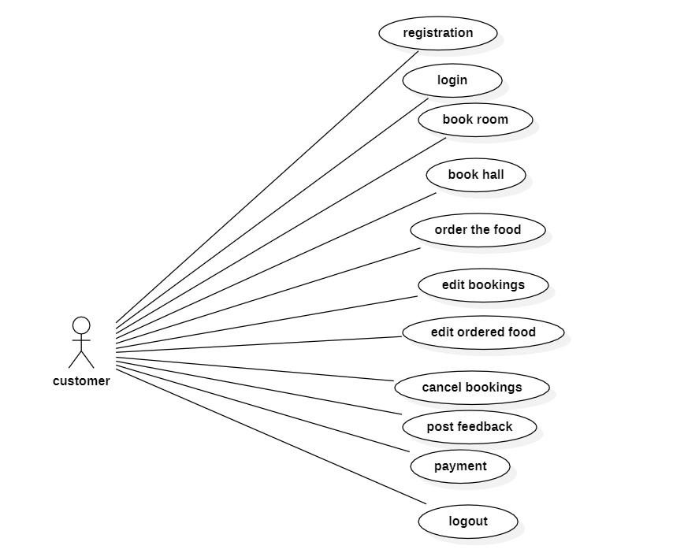
Use Case Diagram for customer

Slide 15
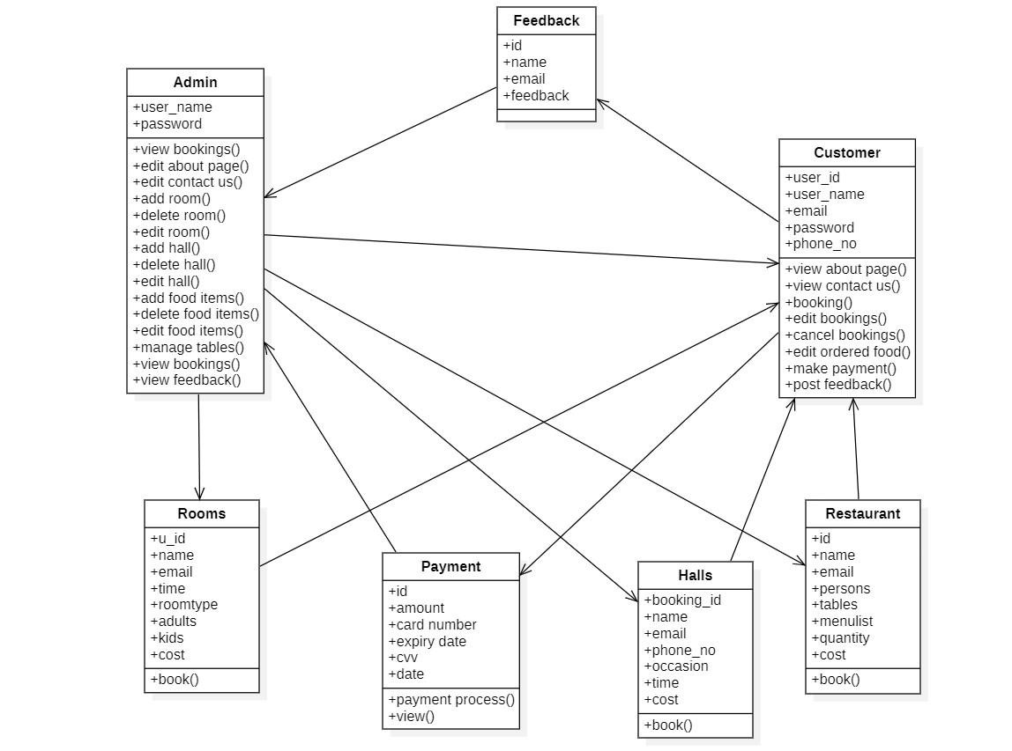
Class Diagram

Slide 16
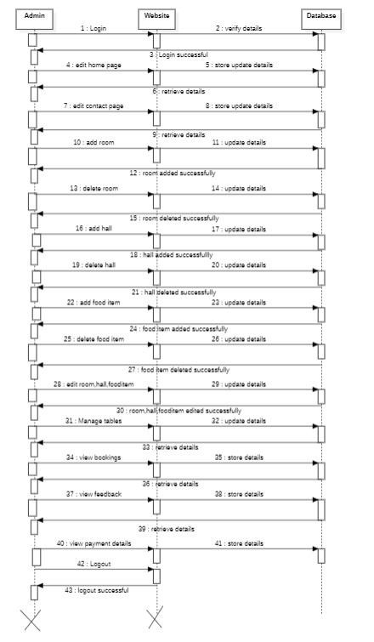
Sequence Diagram for Admin

Slide 17
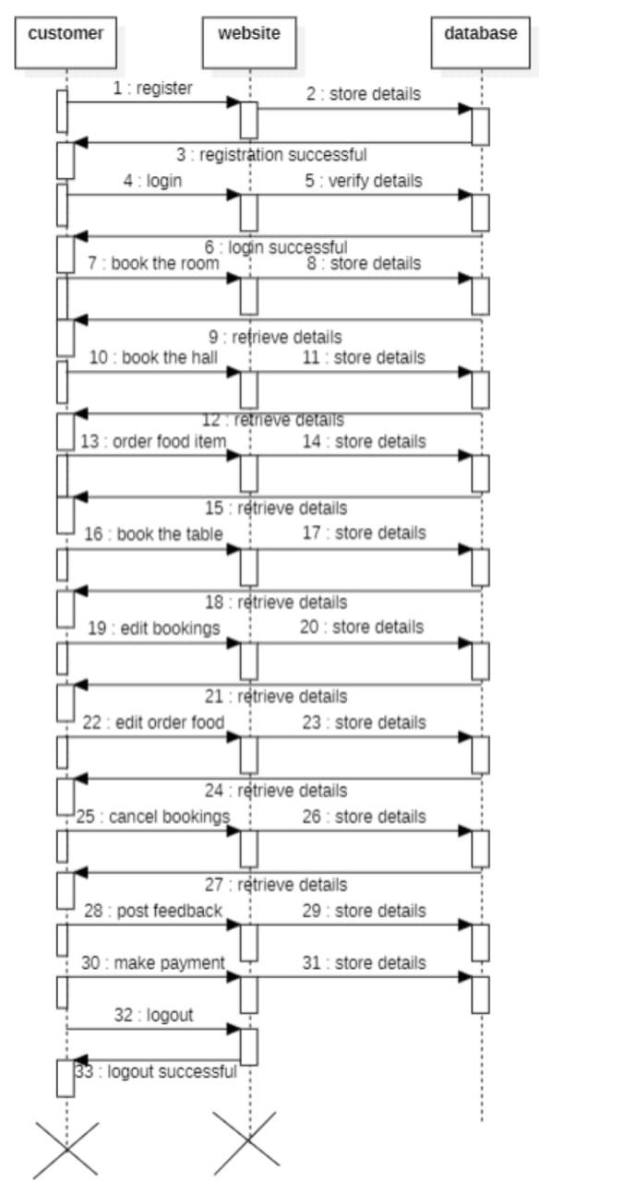
Sequence Diagram for customer

Slide 18
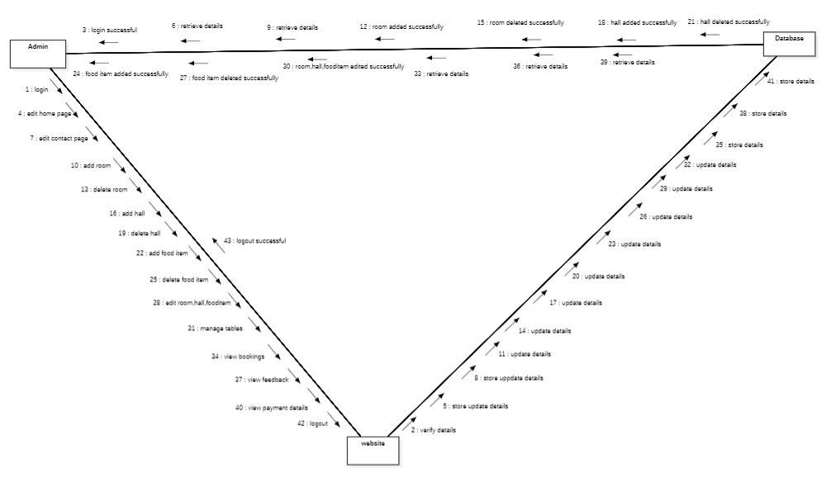
Collaboration Diagram for Admin

Slide 19
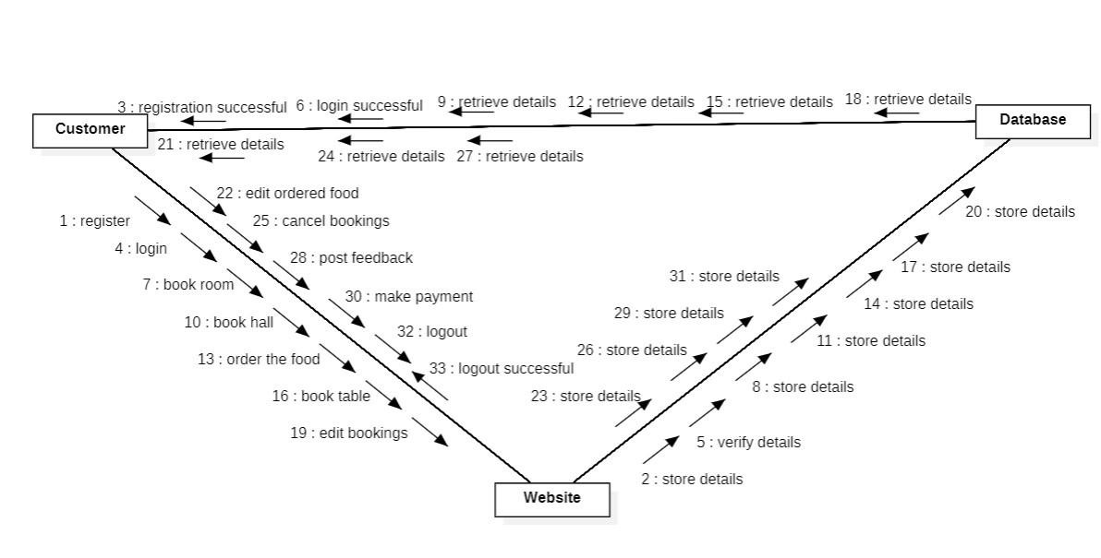
Collaboration Diagram for customer

Slide 20
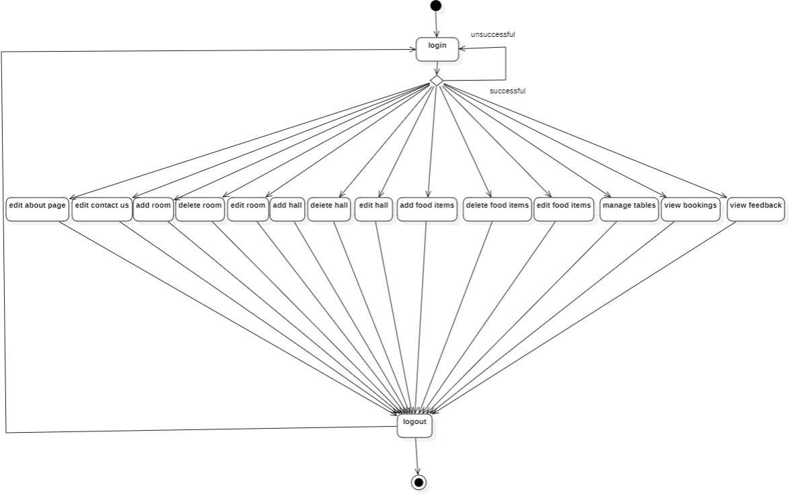
Activity Diagram for Admin

Slide 21
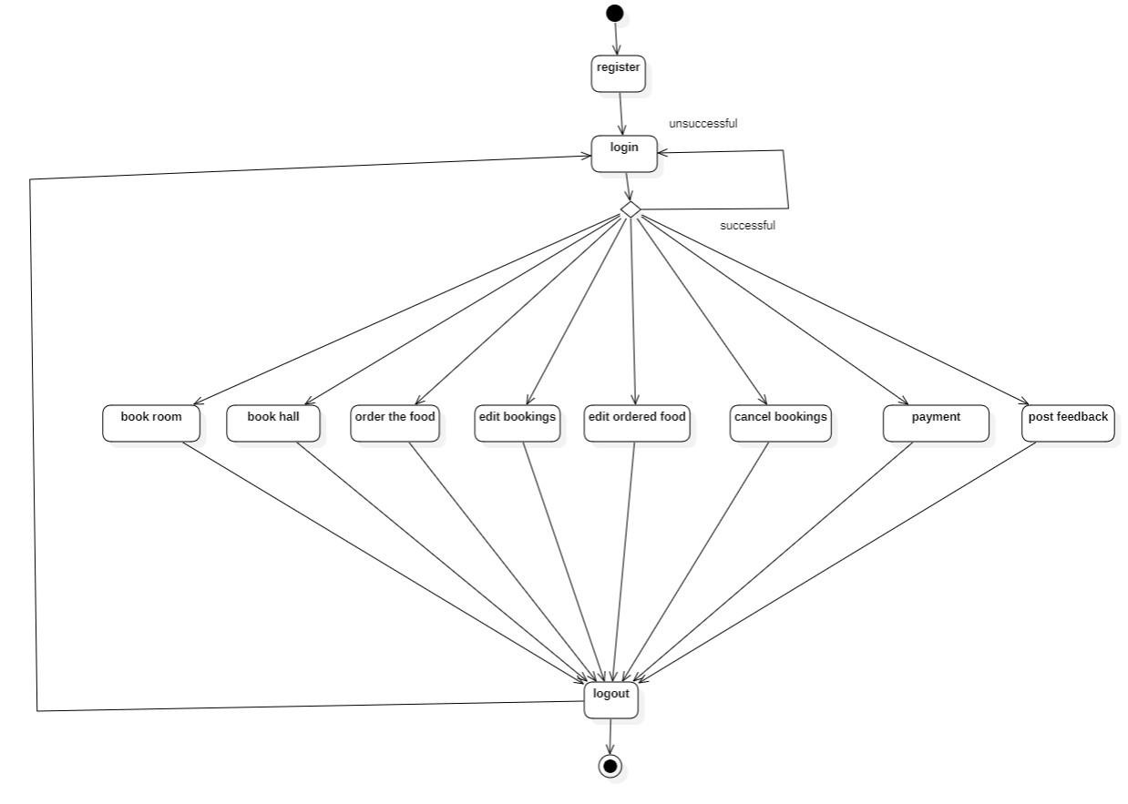
Activity Diagram for customer

Slide 22
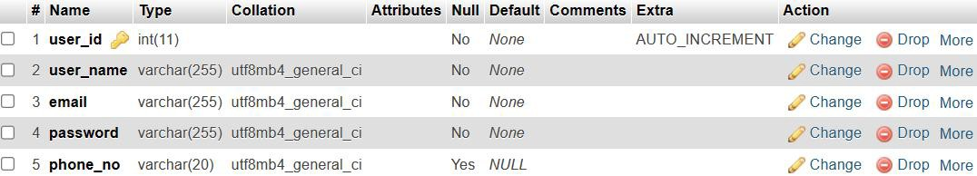
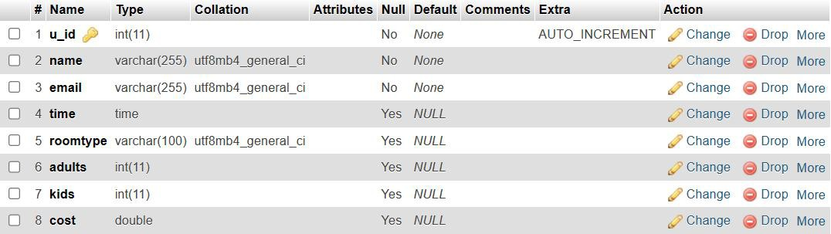
DATABASE DICTIONARY
TABLE FOR CUSTOMER REGISTRATION:
TABLE FOR ROOMS:

Slide 23
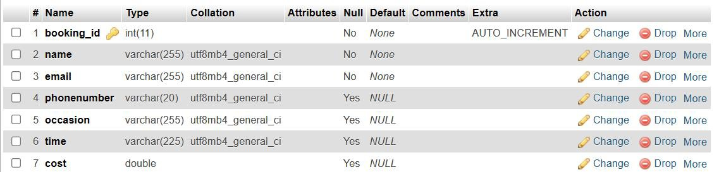
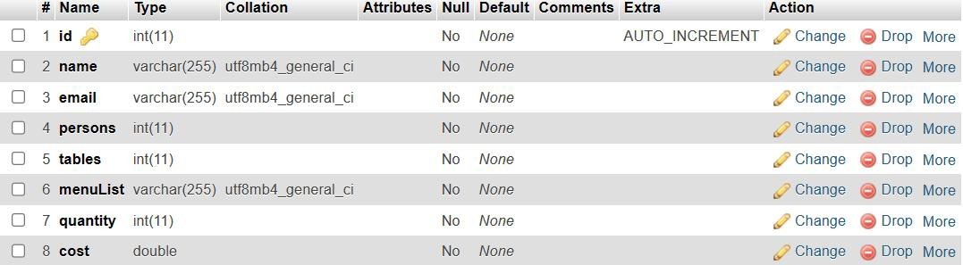
TABLE FOR BANQUETHALL:
TABLE FOR RESTAURANT:

Slide 24
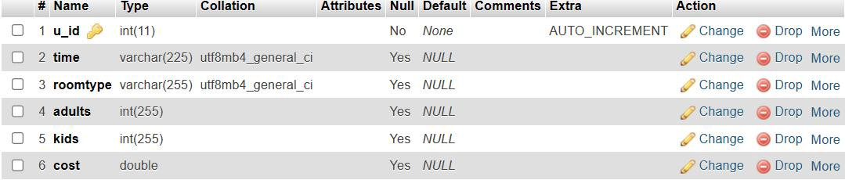
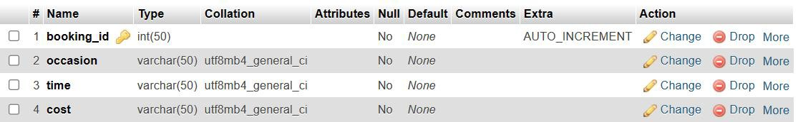
TABLE FOR ADMINROOM:
TABLE FOR ADMINHALL:

Slide 25
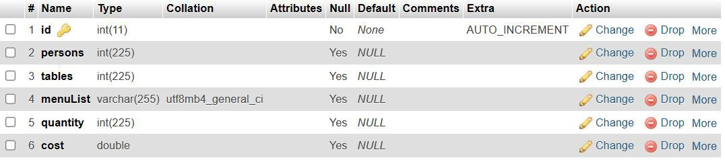
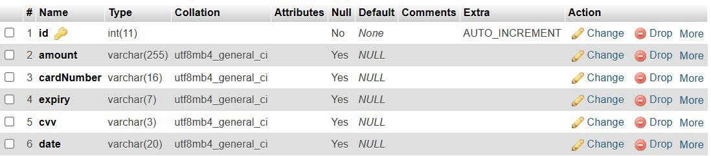
TABLE FOR ADMINRESTAURANT:
TABLE FOR PAYMENT:

Slide 26
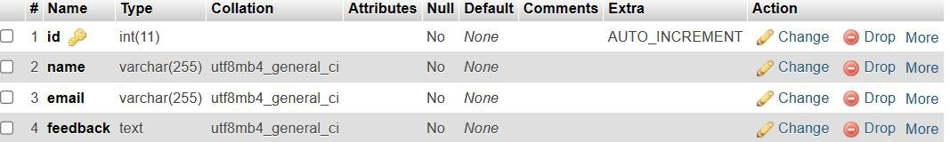
TABLE FOR FEEDBACK:

Slide 27
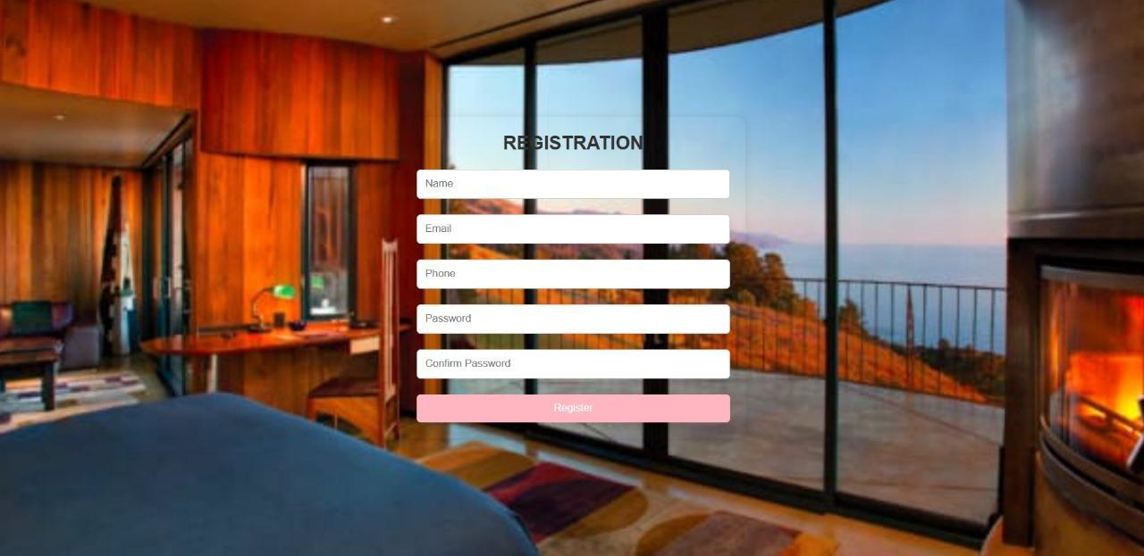
IMPLEMENTATION
FRONTEND DESIGN:
Figure: screenshot for Registration

Slide 28
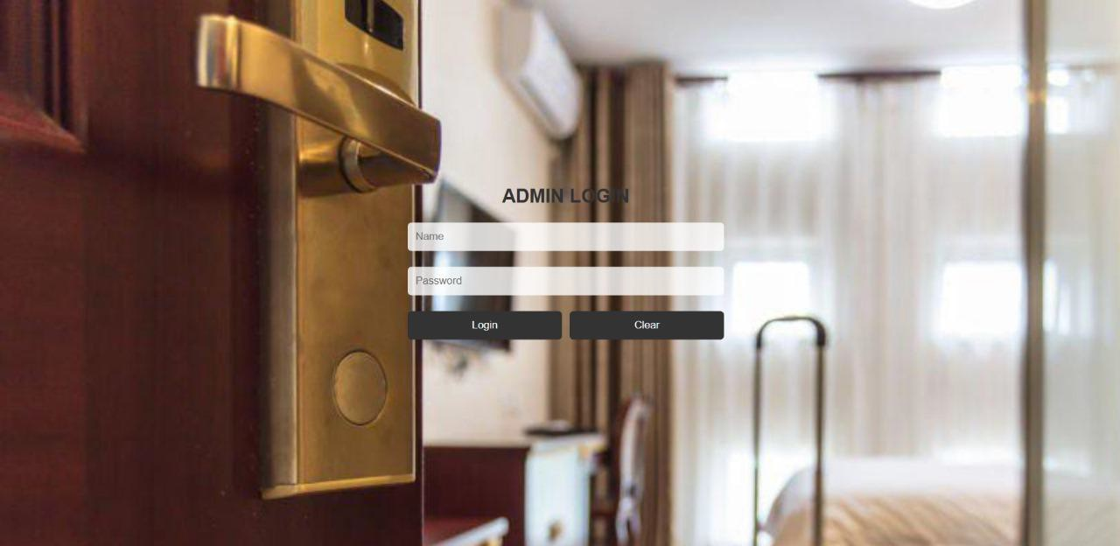
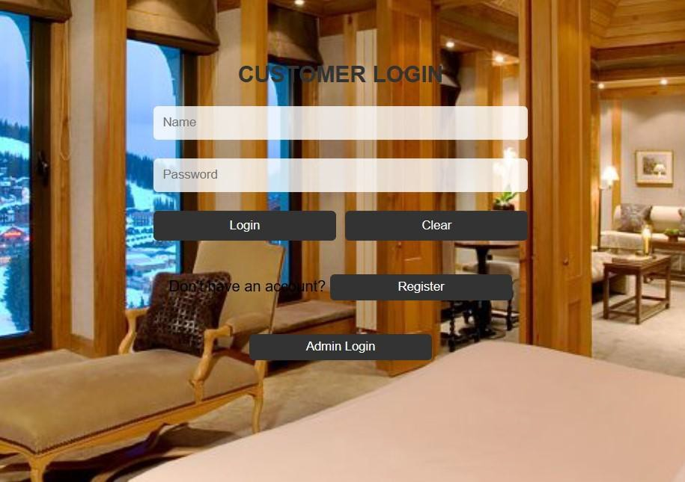
Figure: screenshot for Admin Login
Figure: screenshot for customerLogin

Slide 29
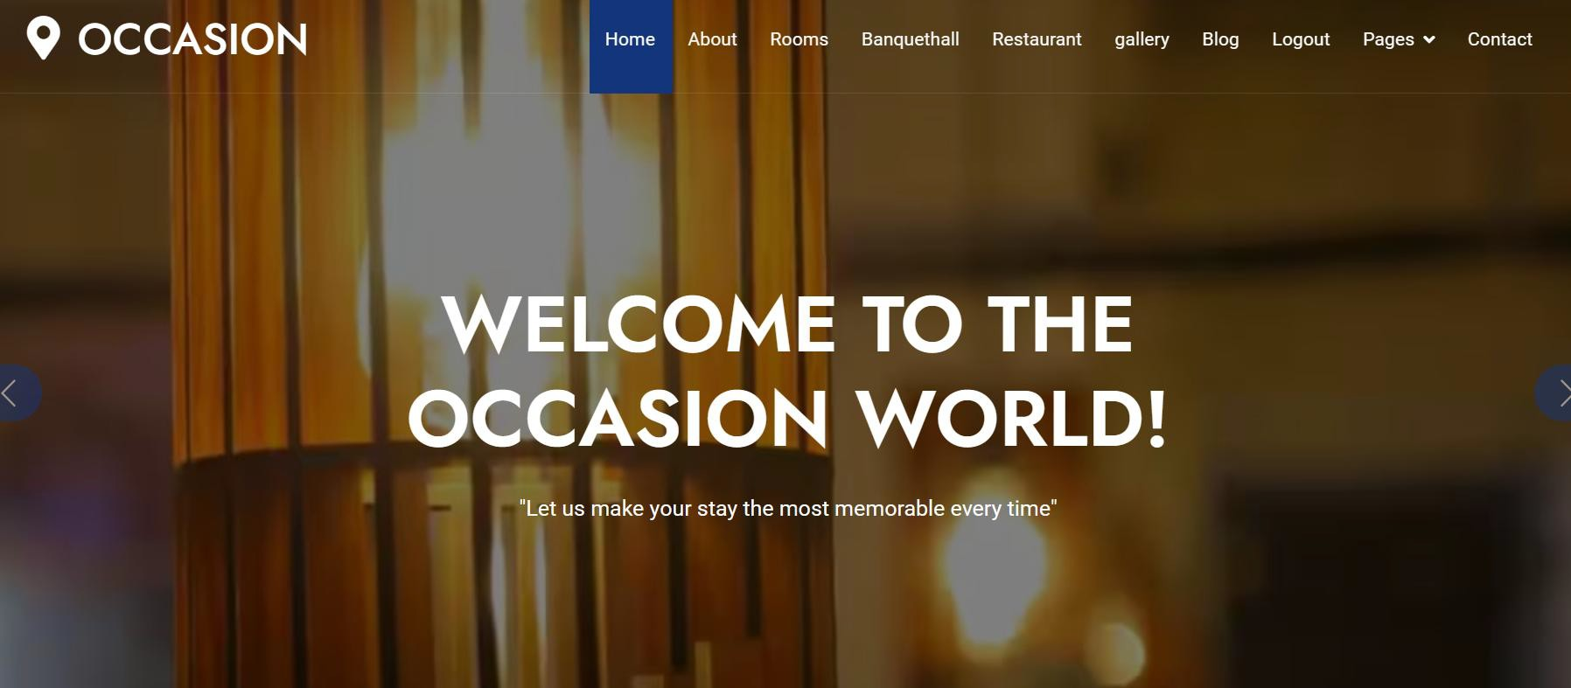
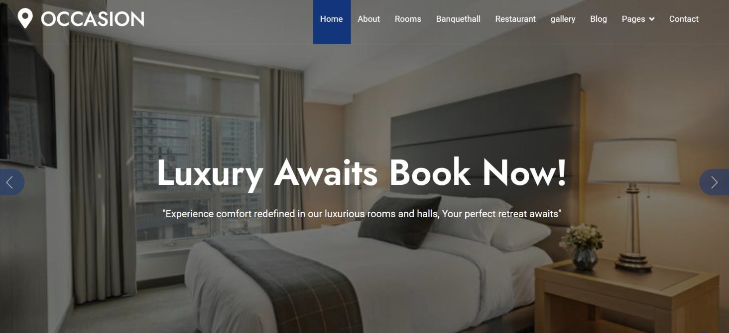
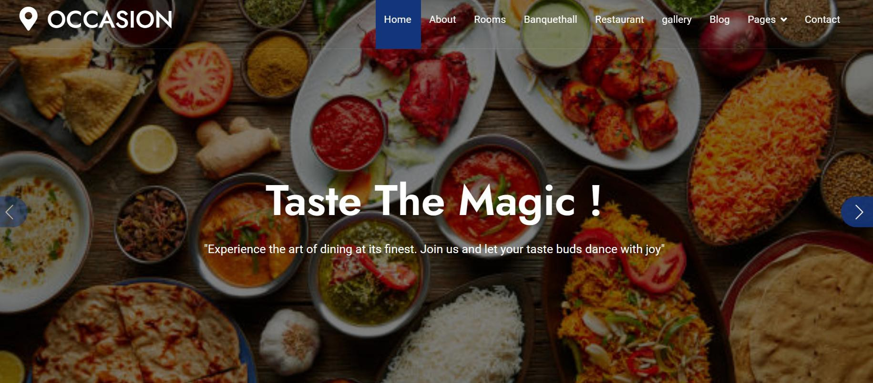
Figure: screenshots for Home page

Slide 30
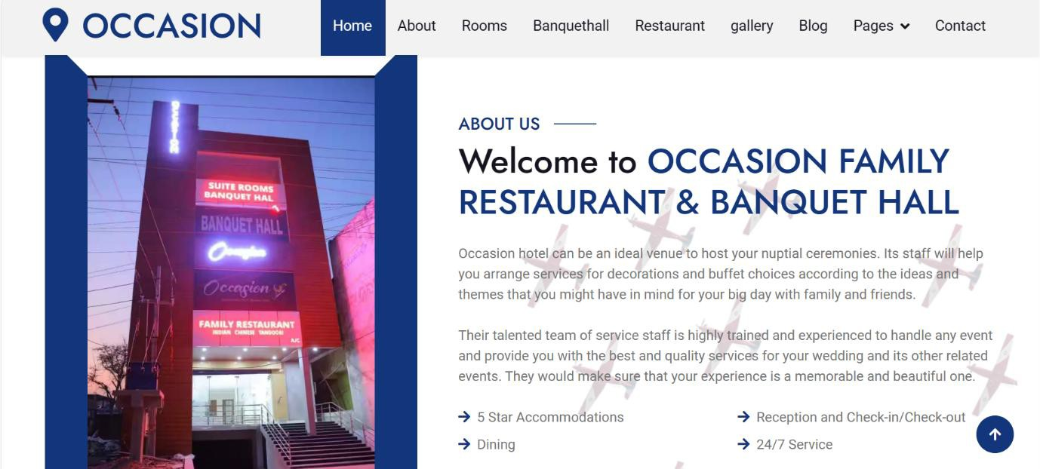
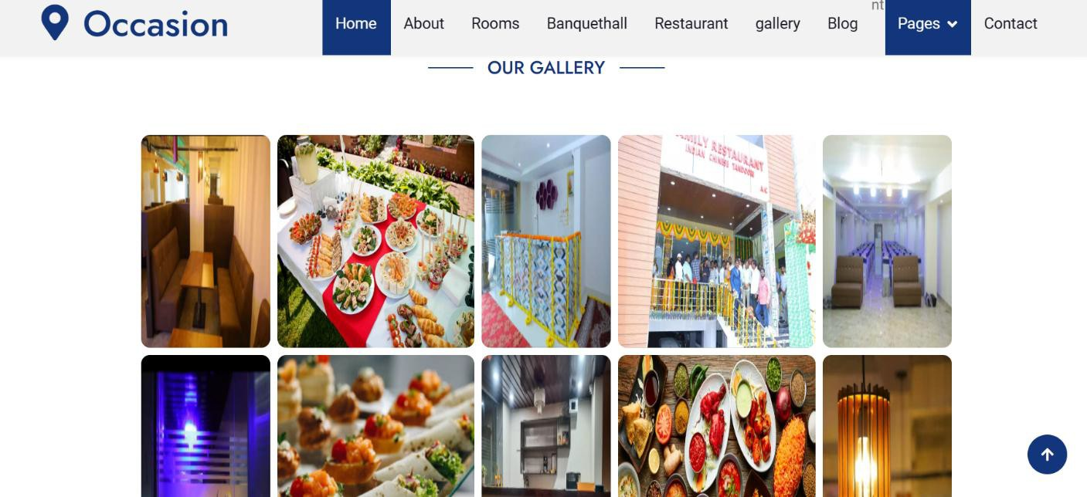
Figure: screenshot for About us page
Figure: screenshot for Gallery page

Slide 31
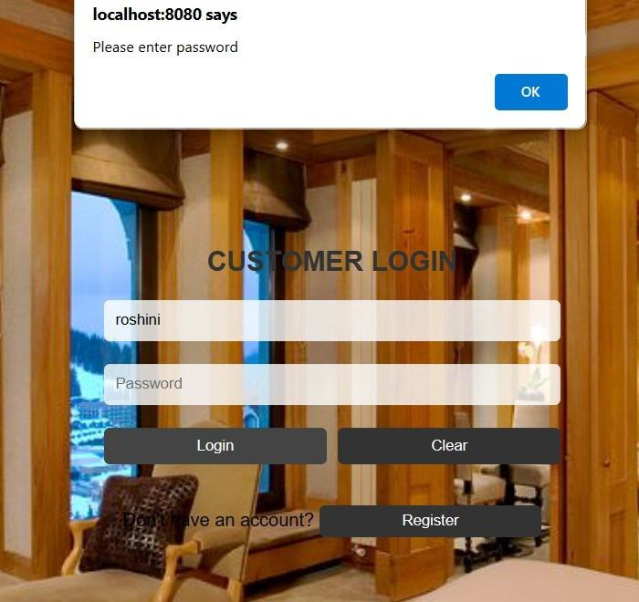
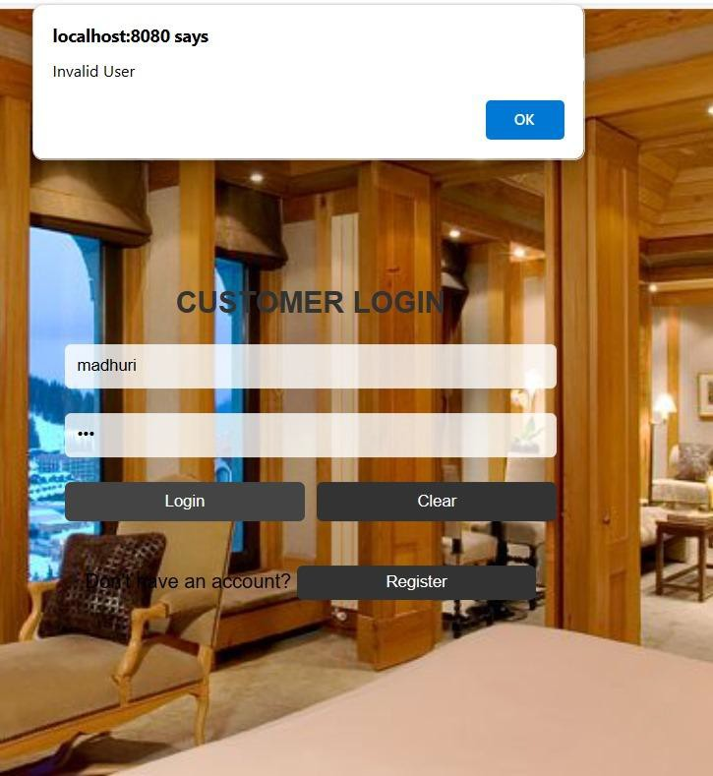
TESTING
Figure: fields are empty
Figure: Invalid user

Slide 32
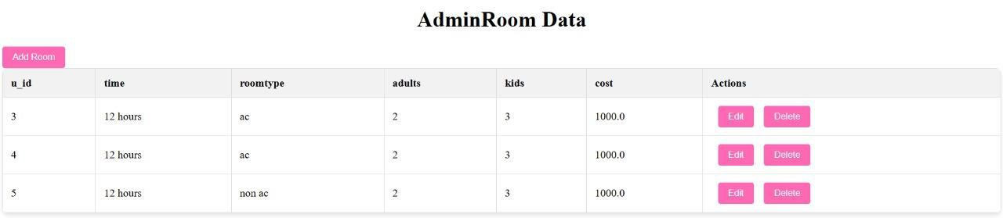
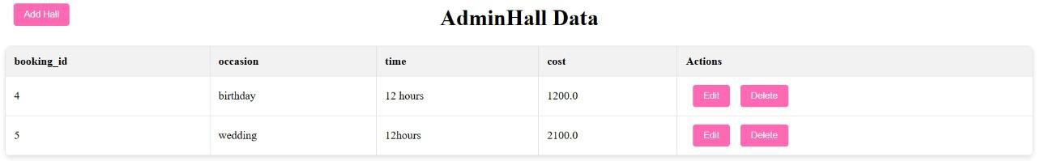
RESULTS
Figure: screenshot for Admin manage rooms
Figure: screenshot for Admin manage halls

Slide 33
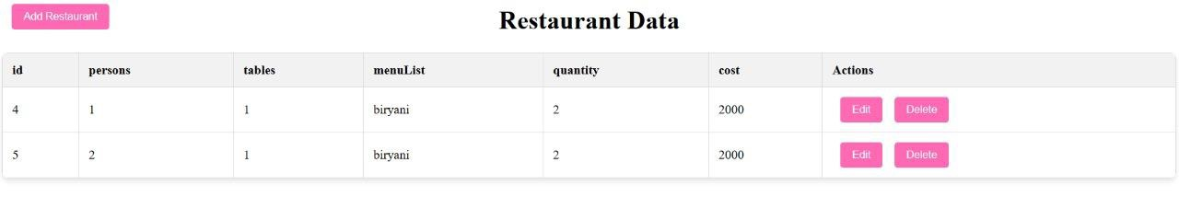
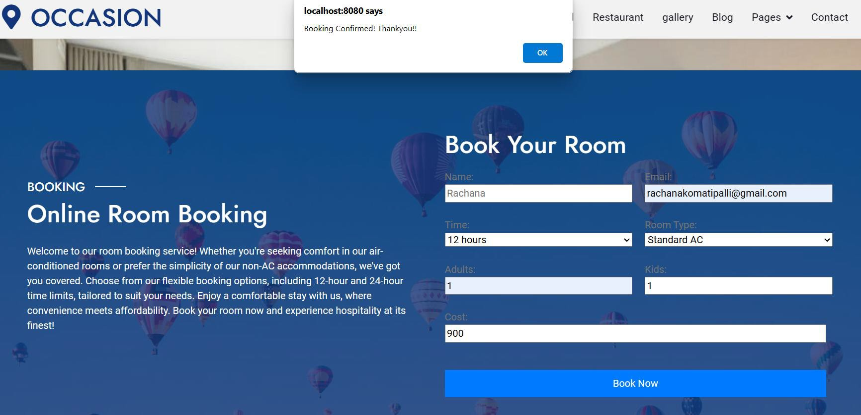
Figure: screenshot for Admin manage restaurant
Figure: screenshot for room booking successful

Slide 34
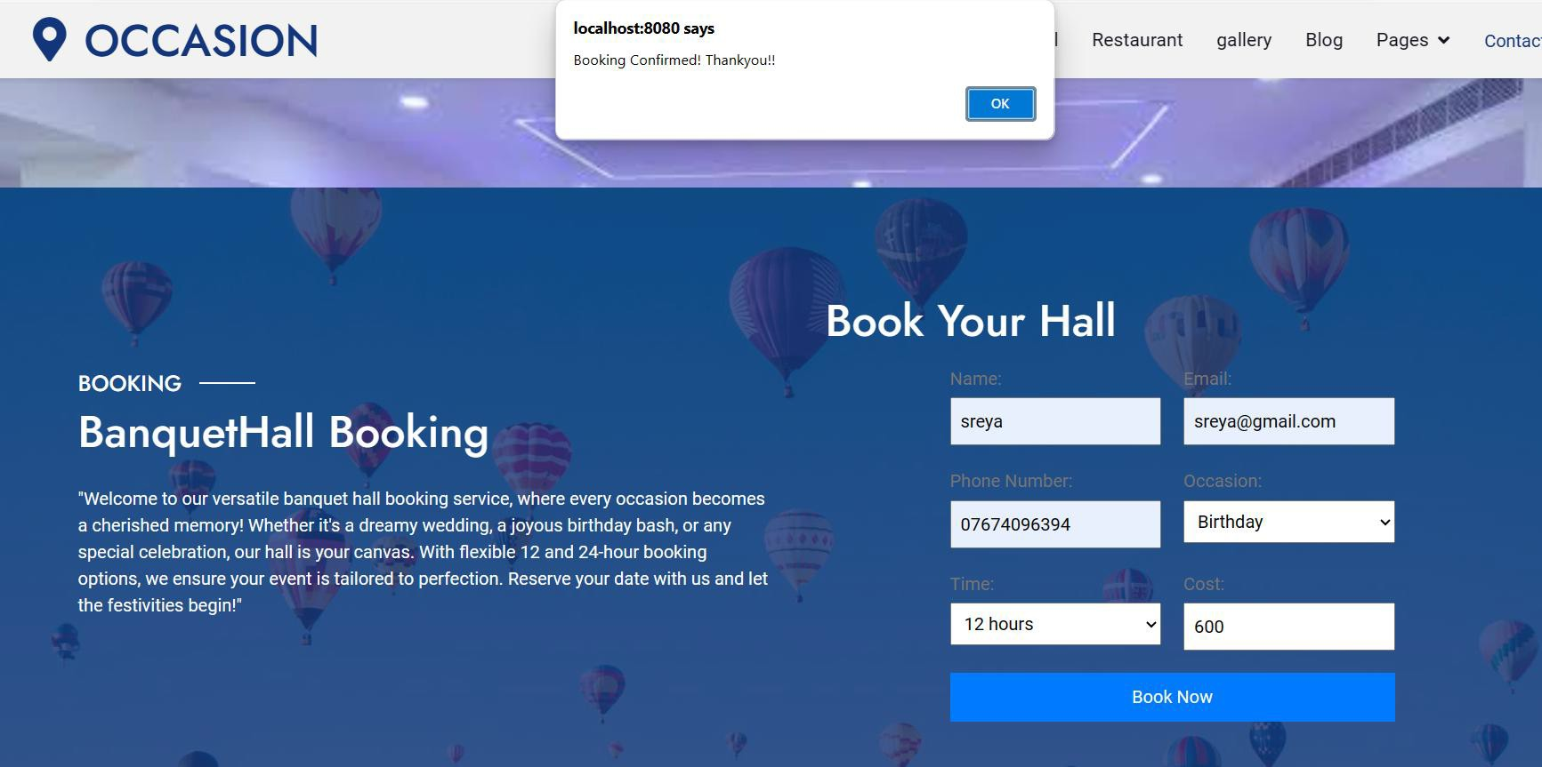
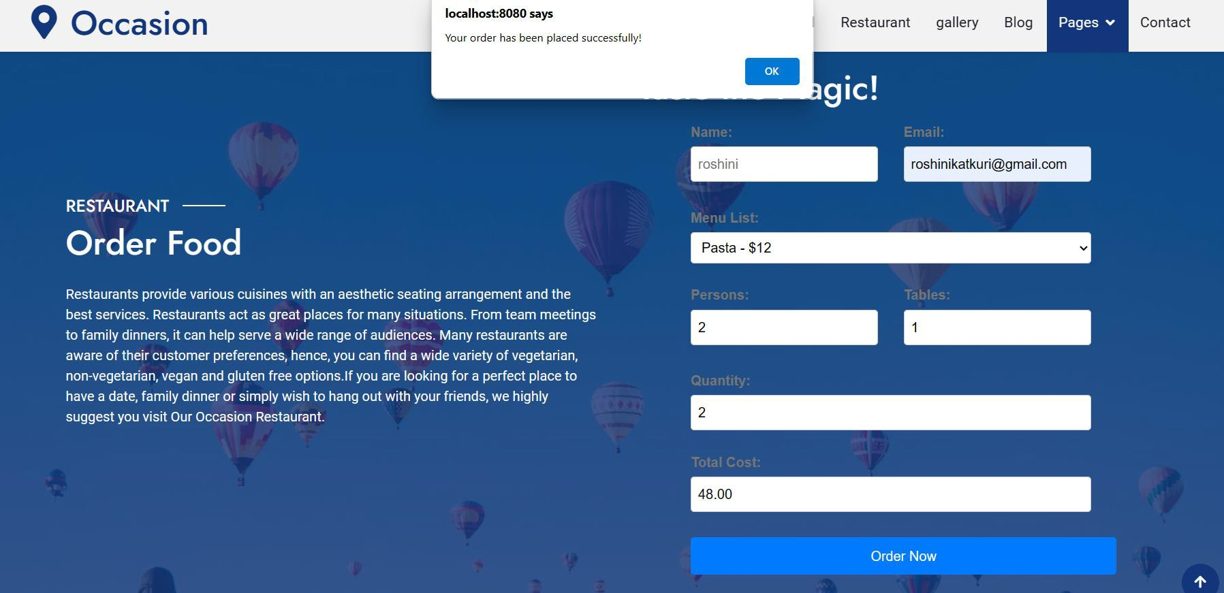
Figure: screenshot for hall booking successful
Figure: screenshot for successful food order

Slide 35
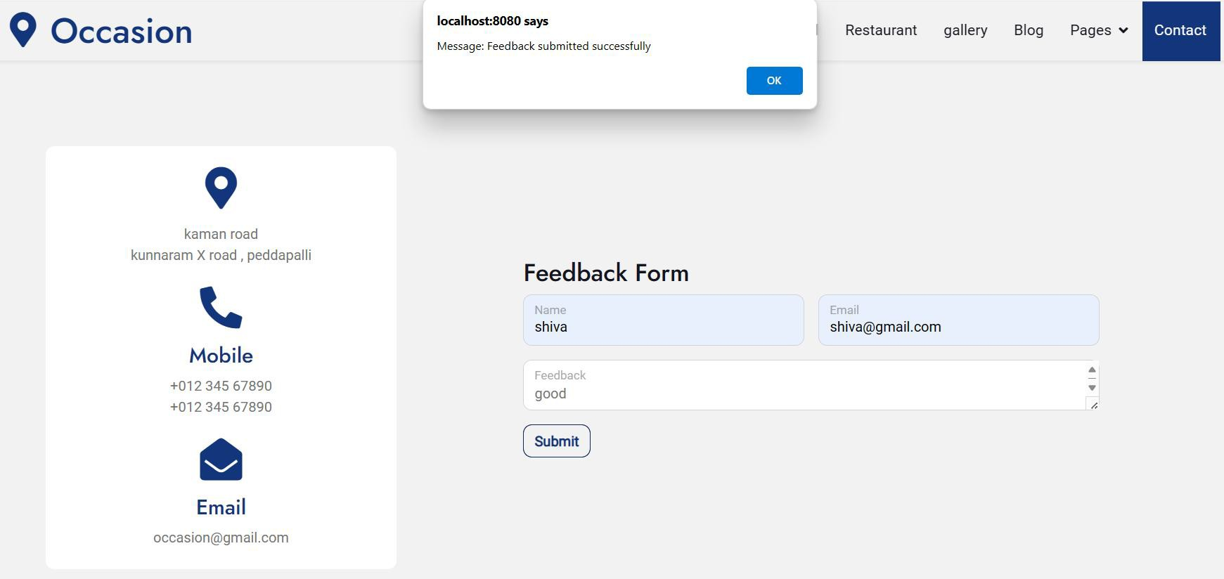
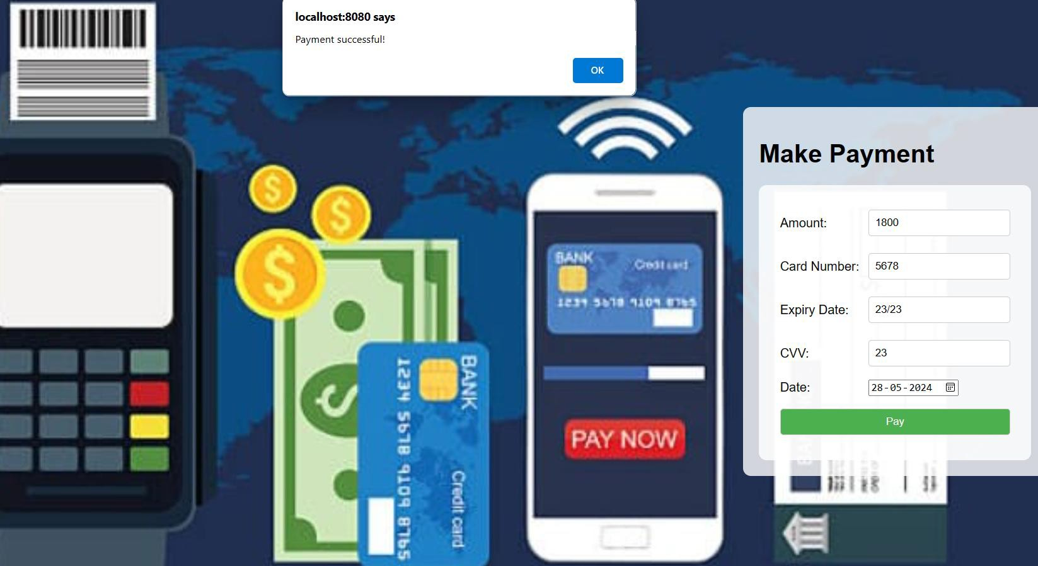
Figure: screenshot for payment successful
Figure: screenshot for feedback successful

Slide 36
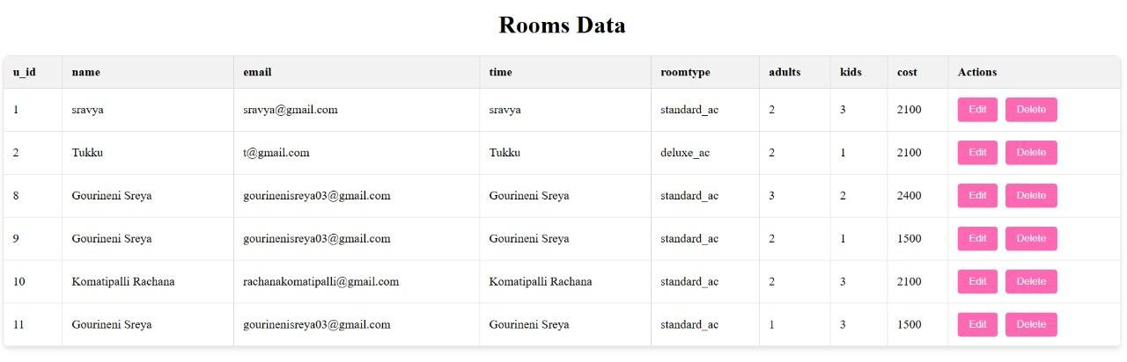
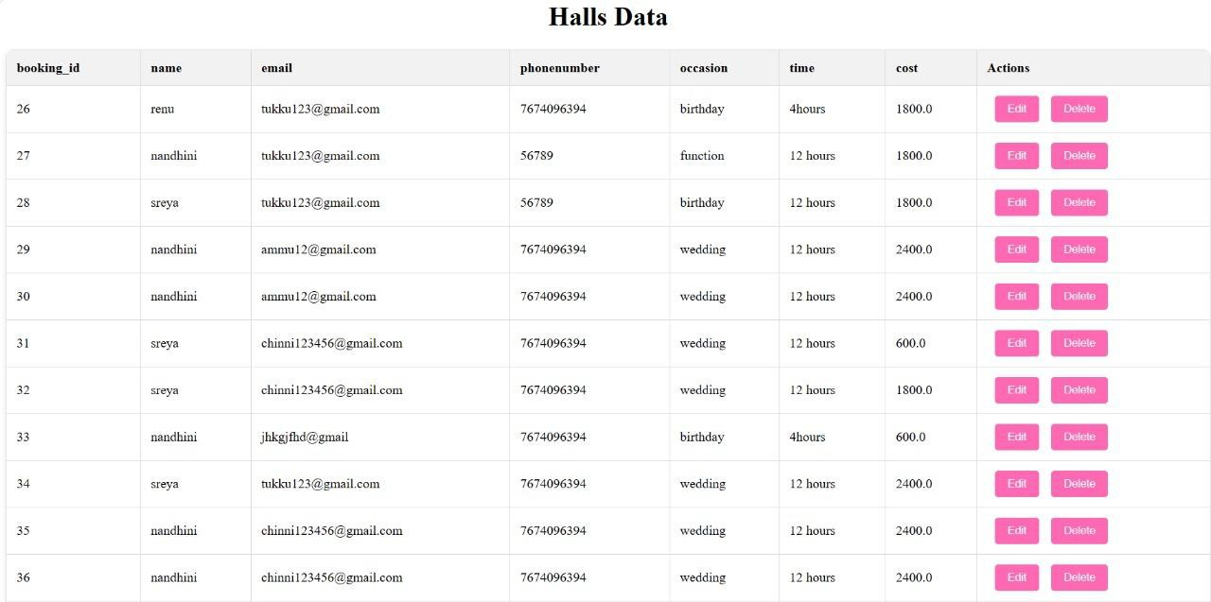
Figure: screenshots for edit and delete bookings

Slide 37
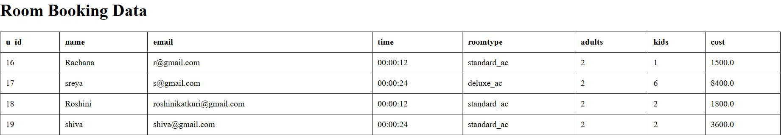
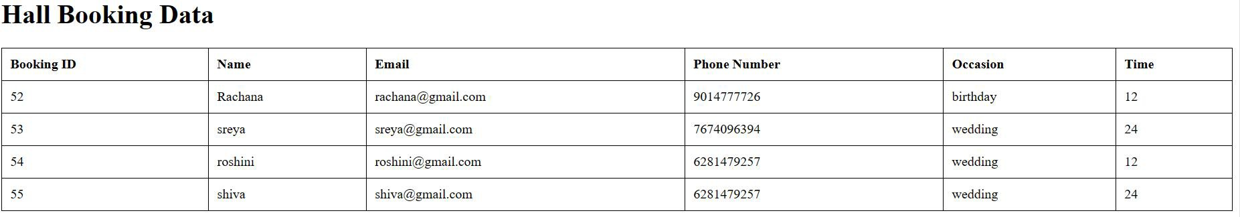
Figure: screenshots for view bookings

Slide 38
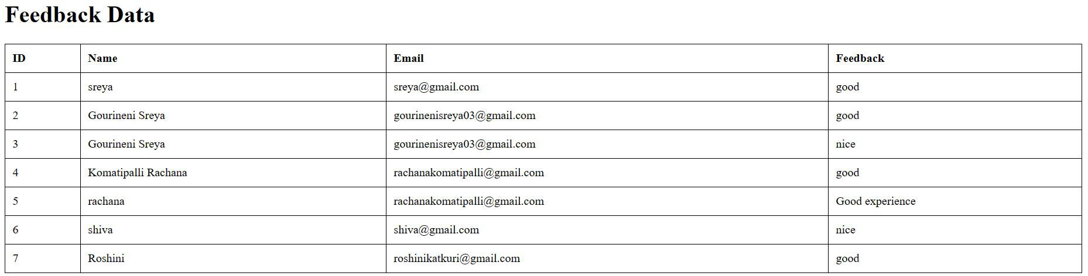
Figure: screenshot for view feedback

Slide 39
CONCLUSION
Finally, in the Online hotel management system, we want to develop a secure, user-friendly Hotel Management System. This System can take care of each member whether its admin or Customer. This System will Help them to properly Manage their hotel and help in growth without creating any hassle. This system is completely secure since every user is provided with a user name and Password so there is no chance of any unauthorized access. Online Payment, Booking, and cancellation make it easier to use. So, using this system will help in reducing the labour and provide more facility for Customer to like Hotel and visit again and again.

Slide 40
FUTURE SCOPE AND ENHANCEMENTS
Enhanced Guest Experience:
Implementing personalized services and experiences for guests based on their preferences and past interactions.
Integrating mobile apps for easy booking, check-in/out, room service requests, and concierge services.
Revenue Management:
Implementing dynamic pricing strategies based on demand, seasonality, and market trends.
Integrating revenue management systems to optimize pricing, inventory, and distribution across various online channels.
•

Slide 41


